Slide 1
SEASIDE CHARTER SCHOOL
PARENT ORIENTATION
2023

Slide 2
OUR GOAL
THIS ORIENTATION IS TO INFORM PARENTS AND GUARDIANS OF IMPORTANT INFORMATION REGARDING OUR SCHOOL PROGRAM. THIS INFORMATION SHOULD ANSWER QUESTIONS YOU MAY HAVE AND PROVIDE YOU WITH CLARITY FOR THE SCHOOL YEAR.

Slide 3
DAILY NEEDS
A HEALTHY SNACK AND WATER BOTTLE
PACKED LUNCH WITH EASY TO OPEN ITEMS
CHANGE OF CLOTHES
POSITIVE ATTITUDE

Slide 4
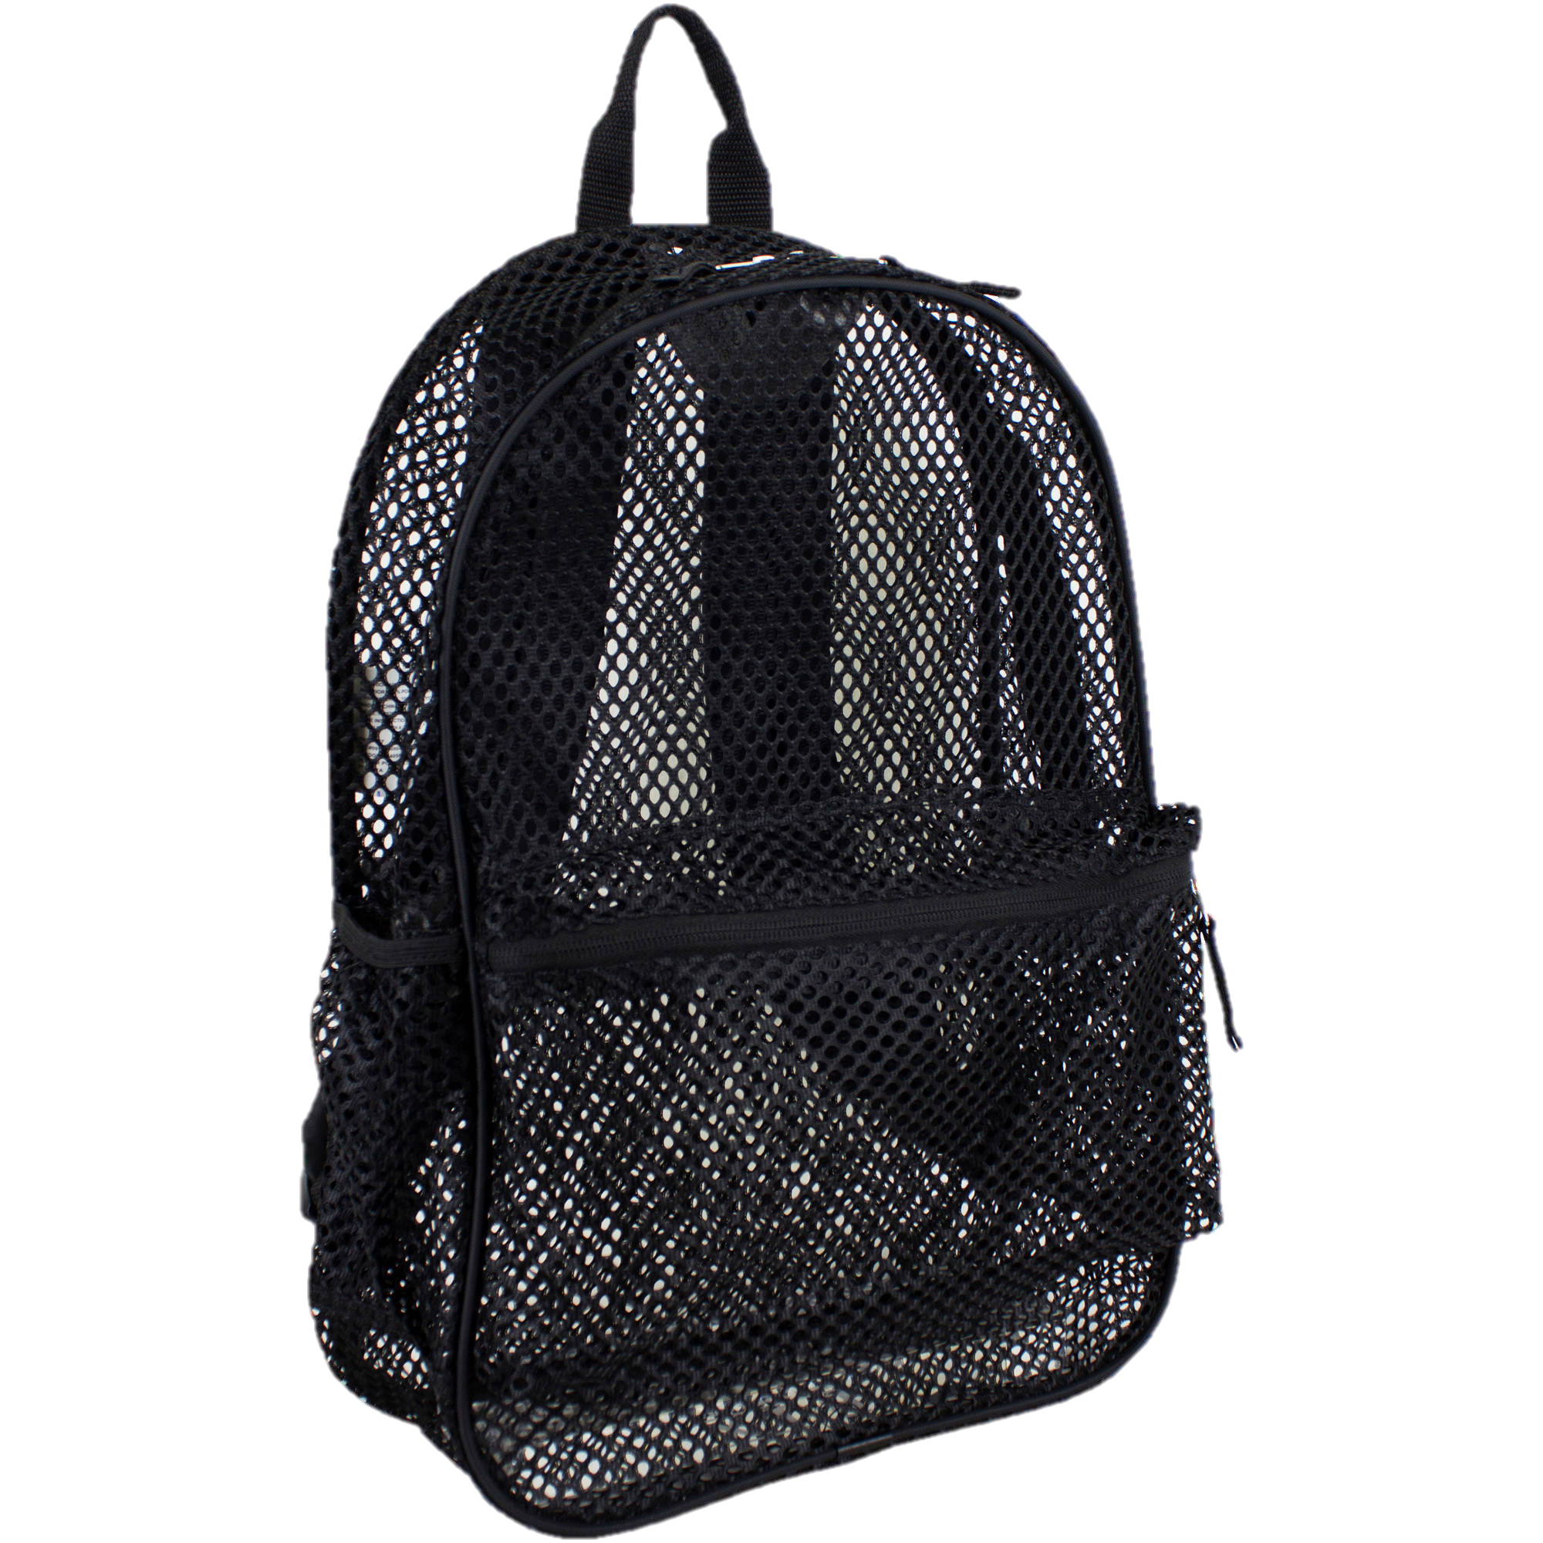
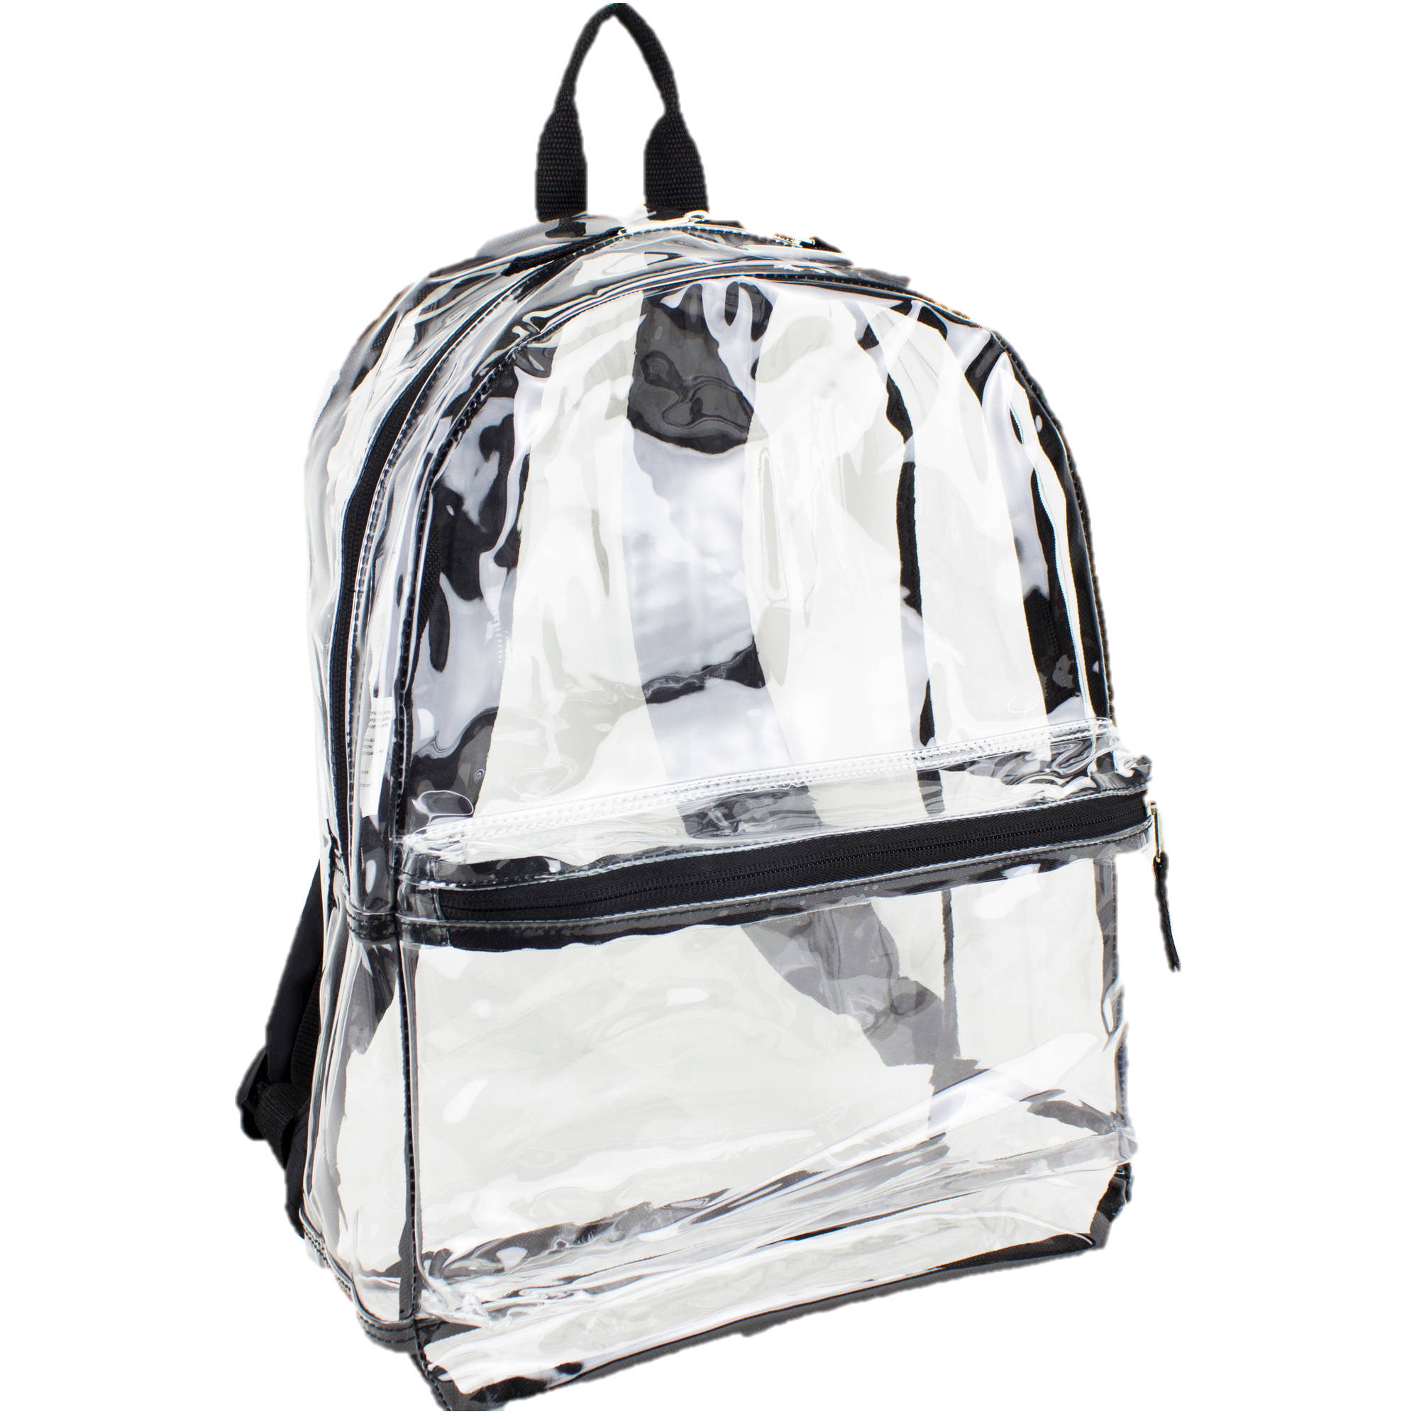
BACKPACK POLICY
STUDENTS MAY CARRY A BACKPACK WHILE ON CAMPUS PROVIDING THAT THE FOLLOWING REQUIREMENTS ARE MET:
ALL BACKPACKS MUST BE SEE THROUGH (PLASTIC OR MESH MATERIAL)
ALL ITEMS IN THE BACKPACK MUST BE VISIBLE AT ALL TIMES
PURSES MUST BE NO LARGER THAN A SHEET OF PAPER (8.5" X 11")

Slide 5
CELL PHONE POLICY
STUDENTS ARE NOT TO POSSESS CELL PHONES OR ELECTRONIC DEVICES ON THEIR PERSON DURING THE SCHOOL DAY. IF A STUDENT BRINGS A CELL PHONE OR AN ELECTRONIC DEVICE TO SCHOOL. CELL PHONES MUST BE TURNED INTO THE TEACHER EACH DAY AT SCHOOL TO BE LOCKED AWAY DURING SCHOOL HOURS. IF A STUDENT NEEDS TO CALL HOME, THEY WILL ASK THEIR TEACHER FOR PERMISSION TO DO SO FROM THE SCHOOL OFFICE PHONE. IF A PARENT HAS A FAMILY EMERGENCY, THEY SHOULD CONTACT THE SCHOOL OFFICE AND SCHOOL PERSONNEL WILL CONTACT THE STUDENT.
VIOLATION OF THIS POLICY RESULTS IN IMMEDIATE CONFISCATION OF THE DEVICE. A PARENT OR GUARDIAN WILL BE RESPONSIBLE TO PICK UP THE DEVICE IN PERSON AFTER SCHOOL. SEASIDE SCHOOL CONSORTIUM IS NOT RESPONSIBLE FOR CELLPHONES OR OTHER ELECTRONIC DEVICES BROUGHT TO SCHOOL BY STUDENTS AND WILL NOT BE LIABLE FOR LOST, DAMAGED, OR DESTROYED CELL PHONES OR DEVICES.
VOLUNTEERS ARE NOT TO USE THEIR PHONES ON SCHOOL GROUNDS AND ARE NOT PERMITTED TO PHOTOGRAPH STUDENTS OR RESHARE PHOTOS FROM PARENTSQUARE ON THEIR PERSONAL SOCIAL MEDIA ACCOUNTS.

Slide 6
DRESS CODE POLICY
BOTTOMS - SHORTS AND SKIRTS MUST BE NO MORE THAN 3 INCHES ABOVE THE KNEE. PANTS, JEANS, CAPRI PANTS, LEGGINGS – WORN WITH A LONG SHIRT/DRESS/TUNIC COVERING BOTTOM, ETC. ALL CLOTHING MUST BE HOLE FREE.
TOPS - ALL TOPS MUST COVER MIDRIFF AND CHEST AREA. NO SPAGHETTI STRAPS, SEE THROUGH OR SHIRTS WITH HOLES.
DRESSES – SHORTS OR LEGGINGS SHOULD BE WORN UNDER DRESSES FOR ACTIVE PLAY OUTSIDE.
SHOES - MUST BE SECURED TO THE FEET AND ARE SUITABLE FOR PLAYING AND WALKING IN DIRT AND SAND. SANDALS MUST BE SECURED IN THE BACK AND HAVE NOT LOOSE HEELS. FLIP-FLOPS ARE NOT ACCEPTABLE. DUE TO THE NATURE OF THE PROPERTY AND THE NEED FOR CHILDREN TO BE READY IMMEDIATELY IN CASE OF FIRE OR EMERGENCIES, KINDERGARTEN CHILDREN WILL HAVE REGULAR SHOES ON IN THE CLASSROOM.
PLEASE AVOID MEDIA CHARACTERS, CARTOONS, GRAPHICS, DISTRACTING DESIGNS, COSTUMES, DRESS UP ITEMS OR CORPORATE LOGOS ON CLOTHING, SHOES, GEAR (LUNCH BOX AND BOTTLE) AND OUTERWEAR (JACKETS, SWEATERS, HATS). WE ASK THAT YOU AVOID CLOTHING AND GEAR THAT WILL INTERFERE WITH PLAY OR IMAGINATION (I.E., DISNEY CHARACTERS) OR ARE NOT AGE APPROPRIATE. THE SEASIDE SCHOOL CONSORTIUM SHIRT IS ALLOWED, OTHER LOGOS (I.E., SPORTS TEAMS, DR. SEUSS) WILL BE ALLOWED AS PART OF COMMUNITY BUILDING.
JEWELRY – NO WATCHES (THEY GET LOST OR BROKEN), NECKLACES, BRACELETS, HOOP/HANGING EARRINGS, OR RINGS. POST EARRINGS ARE PERMITTED.
HATS (HOODS, BASEBALL CAPS, BEANIES) CAN BE WORN OUTSIDE ONLY.
SENDING IN A CHANGE OF CLOTHES IS RECOMMENDED.

Slide 7
AFTER SCHOOL CLUBS
CLUBS MEET ONCE A WEEK FOR 8 WEEKS ON A DESIGNATED DAY. CLUBS ARE $75 EACH, PM EXTENDED DAY STUDENTS RECEIVE ONE CLUB FOR $10. EACH NINE WEEKS WE OFFER CLUBS BASED ON WHAT OUR STAFF WOULD LIKE TO OFFER. CLUB DESCRIPTIONS AND SIGN UP ARE ANNOUNCED ON PARENTSQUARE ABOUT 3 WEEKS BEFORE THE CLUB START DATE. CLUBS ARE GRADE LEVEL SPECIFIC. YOUR STUDENT CAN ONLY JOIN A CLUB THAT SERVICES THEIR GRADE LEVEL. PLEASE BE RESPECTFUL OF OUR STAFFS DECISIONS.
TO SIGN UP FOR A CLUB YOU WILL NEED TO PUT YOUR STUDENTS NAME ON THE SIGN UP WITH THE CLUB YOUR CHILD WOULD LIKE TO PARTICIPATE IN. ONLY IF THE CLUB SIGN UP IS FULL, COMMENT DIRECTLY BELOW WITH THE CLUB YOU WANT FOR YOUR CHILD TO JOIN THE WAITLIST. IF A CLUB HAS A LARGE NUMBER OF CHILDREN ON THE WAIT LIST WE ATTEMPT TO GET A SECOND STAFF MEMBER TO HELP WITH THE CLUB TO INCREASE THE CLUB SIZE. AFTER YOU SIGN UP FOR THE CLUB AND SECURE ONE OF THE AVAILABLE SPOTS YOU WILL THEN RECEIVE AN INVOICE VIA PARENTSQUARE. PLEASE BE PATIENT IT TAKES A WHILE TO GET INVOICES OUT TO EVERYONE. ONCE YOUR INVOICE IS PAID YOU WILL BE PUT INTO A GROUP FOR THE CLUB. IN THAT GROUP YOU WILL RECEIVE ANNOUNCEMENTS SPECIFIC TO THE CLUB FROM YOUR CLUB LEADERS.

Slide 8
SPORTS TEAMS
WE ARE DIPPING OUR TOES IN AND STARTING BASKETBALL AND SOCCER TEAMS WITH THE LOCAL 5TH/6TH GRADE CHARTER SCHOOLS SPORTS LEAGUE. OUR BASKETBALL TEAMS WILL BE AT EACH CAMPUS WITH A BOYS AND GIRLS TEAM, THE SOCCER TEAM WILL BE CO-ED. TRY OUTS FOR BASKETBALL WILL BEGIN AROUND OCTOBER AND TRY OUTS FOR SOCCER WILL BEGIN AROUND FEBRUARY. WE NEED VOLUNTEERS TO HELP COACH THESE TEAMS. WE CANNOT MAKE THIS HAPPEN WITHOUT VOLUNTEER COACHES. IF YOU ARE INTERESTED, PLEASE REACH OUT TO MR.SHANTEAU, DSHANTEAU@SEASIDECHARTER.ORG
ALWAYS REMEMBER THAT MIDDLE SCHOOL STUDENTS CAN TRY OUT FOR SPORTS AT THEIR NEIGHBORHOOD SCHOOLS GIVEN THEY MEET THE FOLLOWING REQUIREMENTS:
SEASIDE SCHOOL CONSORTIUM CANNOT OFFER THAT SPECIFIC SPORT AT SCHOOL. (THE PRINCIPAL WILL HAVE A LETTER STATING THAT THE SCHOOL DOES NOT OFFER THAT SPORT TO PROVIDE THE NEIGHBORHOOD SCHOOL. SEASIDE SCHOOL CONSORTIUM DOES NOT CURRENTLY OFFER MIDDLE SCHOOL SPORTS PROGRAMS FOR 7th AND 8th )
THE STUDENT HOLDS A 2.0 OR HIGHER GPA AND DOES NOT HAVE TWO F’S.
LIVES WITHIN THE SCHOOL ZONE THEY INTEND TO PLAY SPORTS AT.
THE STUDENT DOES NOT TURN 15 BEFORE SEPTEMBER 1ST OF THAT YEAR.
STUDENTS ONLY HAVE THREE YEARS OF ELIGIBILITY ONCE THEY BEGIN 6TH GRADE.

Slide 9
ARRIVAL
CAR LINE BEINGS AT 8:15AM. NO STUDENTS ARE PERMITTED IN THE BUILDING BEFORE THIS TIME UNLESS THE STUDENT IS ENROLLED IN AM EXTENDED DAY.
ANY STUDENTS WHO ARRIVE TO SCHOOL PAST 8:45AM WILL BE COUNTED TARDY, UNLESS THE CARLINE HAS EXTENDED PAST THAT TIME.
PLEASE REMAIN IN YOUR VEHICLE DURING CAR LINE.
STAFF ARE NOT PERMITTED TO BUCKLE/UNBUCKLE OR UNLATCH YOUR CHILD FROM THEIR CAR SEAT. PLEASE ASSIST STAFF WITH THIS TASK.
IF YOUR CHILD IS LATE, YOU MUST WALK THEM IN TO THE FRONT OFFICE AND SIGN THEM IN.

Slide 10
DISMISSAL
WE ARE NOT ALLOWED TO PLACE YOUR CHILD IN YOUR CAR WITHOUT A PROVIDED CAR TAG VISIBLE.
  IN THE CASE YOU LEFT IT AT HOME OR MISPLACED IT, PLEASE PULL IN AND PARK. OFFICE STAFF WILL NEED TO SEE YOUR PHOTO ID.
  IF YOU NEED ADDITIONAL CAR TAGS FOR ADULTS ON YOUR “CLEARED TO PICK UP” LIST PLEASE REACH OUT TO YOUR OFFICE STAFF.
WE WILL OPEN THE SIDE OF THE VEHICLE CLOSEST TO US TO LET YOUR CHILD IN. THEY WILL NEED TO BE ABLE TO MOVE AROUND ANY POSSIBLE OBSTRUCTIONS.
PLEASE LEAVE PETS AT HOME.
PLEASE PULL UP AND OUT OF THE LINE OF TRAFFIC TO FINISH BUCKLING UP DURING PICK UP.

Slide 11
STUDENT CHECK OUT POLICY
STUDENTS ARE NOT RELEASED AFTER 2:45 PM UNLESS THERE IS A SERIOUS EMERGENCY.
STUDENTS ARE NOT RELEASED TO ANY ADULT THAT IS NOT ON THEIR EMERGENCY CONTACT FORM WITHOUT PRIOR WRITTEN AUTHORIZATION FROM THEIR PARENT OR GUARDIAN.
IF THERE IS EVER A CHANGE IN DISMISSAL PLANS, THE PARENT/GUARDIAN MUST INFORM THE TEACHER IN ADVANCE OF THE CHANGE.

Slide 12
COMMUNICATION
COMMUNICATION PLATFORMS:
    PARENT SQUARE: THIS IS OUR PRIMARY LINE OF COMMUNICATION WITH FAMILIES. INFORMATION TO JOIN IS SENT VIA EMAIL AFTER REGISTRATION. EMAIL CRT@SEASIDECHARTER.ORG IF YOU HAVE ANY ISSUES.
    EMAIL: EMAIL ADDRESSES FOR ADMINISTRATION, FRONT OFFICE AND MORE CAN BE FOUND IN YOUR SCHOOLS RESOURCE HUB ON PARENTSQUARE.
    TEACHERS WILL SEND WEEKLY NEWSLETTERS VIA PARENTSQUARE
    FOLDERS WILL BE SENT HOME EACH TUESDAY WITH PAPER COMMUNICATION, STUDENT WORK, ETC
TIMELINES:
    WHEN COMMUNICATING A CONCERN/FEEDBACK PLEASE ALLOW 48 BUSINESS HOURS FOR A RESPONSE. THIS ALLOWS FOR INVESTIGATION OF THE CONCERN, AND CONSULTATION WITH LEADERSHIP.
    IF YOU NEED FURTHER HELP OR DID NOT RECEIVE A RESPONSE, CONTACT YOUR SCHOOL ADMINISTRATOR.

Slide 13
OTHER IMPORTANT INFORMATION
ENSURE YOU NOTIFY THE SCHOOL IF ANY CONTACT INFORMATION CHANGES.
SEASIDE’S PARENT HANDBOOK AND CODE OF CONDUCT ARE LOCATED ON OUR WEBSITE WWW.SEASIDECHARTER.ORG/CURRENTFAMILIES
FOR A CAMPUS SPECIFIC ORIENTATION POWERPOINT PLEASE VISIT THE RESOURCE TAB IN YOUR PARENT SQUARE ACCOUNT.
OTHER IMPORTANT CAMPUS SPECIFIC INFORMATION SUCH AS STAFF DIRECTORY AND CAMPUS MAPS ARE LOCATED IN THE RESOURCE TAB OF YOUR PARENT SQUARE ACCOUNT.

Slide 14

SNACK & LUNCH
TIME FOR SNACK IS LIMITED- PLEASE SEND ONLY HEALTHY FOOD ITEMS LABELED FOR SNACK AND ONE JUICE OR WATER.
PACK ITEMS THAT CAN BE EASILY OPENED FOR STUDENT INDEPENDENCE.
WE DO NOT HAVE A MICROWAVE OR FRIDGE FOR STUDENT USE.
SUPPLY UTENSILS IF NEEDED.
WE ARE A PEANUT FREE SCHOOL.
SUNSHINE KITCHEN IS AVAILABLE FOR EMERGENCIES/FORGOTTEN LUNCHES.

Slide 15

BIRTHDAY CELEBRATIONS
IF YOU WISH TO PROVIDE A SNACK ON YOUR CHILD’S BIRTHDAY YOU MUST NOTIFY THE TEACHER IN ADVANCE. PLEASE PROVIDE ENOUGH SNACKS FOR THE ENTIRE CLASS.
SHARED SNACKS SHOULD FOLLOW OUR FOOD GUIDELINES- PEANUT FREE AND HEALTHY. NO CAKES, CUPCAKES, COOKIES OR OTHER SUGARY TREATS. WE RECOMMEND ITEMS LIKE POPCORN, FROZEN FRUIT BARS AND FRUIT PLATTERS.

Slide 16
REPORT CARDS AT SEASIDE
NARRATIVES ARE SENT HOME EVERY 9 WEEKS.
NARRATIVES PAINT A COMPREHENSIVE PICTURE OF THE WHOLE CHILD, ADDRESSING THEIR HEAD, HEART, AND HANDS IN COMBINED FLORIDA STANDARDS CHECKLIST AND TRADITIONAL NARRATIVE FORMAT.
NARRATIVES ARE SENT HOME IN ADDITION TO REPORT CARDS.
REPORT CARDS CAN BE FOUND ON FOCUS.
PARENTS CAN ACCESS THEIR STUDENT GRADES THROUGHOUT THE YEAR THROUGH THEIR DCPS FOCUS ACCOUNT.
I-READY PROGRESS MONITORING ASSESSMENT DATA WILL BE SENT HOME THREE TIMES A YEAR.

Slide 17
CURRICULUM, INSTRUCTION & HOMEWORK
INTEGRATE WALDORF INSPIRED PEDAGOGY AND STATE STANDARDS
HEAD, HEART, HANDS
  ARTS, MOVEMENT, HANDS-ON ACTIVITIES, STORY TELLING, RHYTHM AND REPETITION.
ROOTED IN CHILD DEVELOPMENT
  CURRICULUM AND STORIES MEET STUDENTS WHERE THEY ARE DEVELOPMENTALLY
INTERPERSONAL AND INTRAPERSONAL
  SOCIAL EMOTIONAL DEVELOPMENT AND CONNECTEDNESS WITH THE WORLD (NATURE AND OTHERS)

Slide 18



THIS IS OUR SCHOOL.
LET PEACE DWELL HERE.
LET THE ROOMS BE FULL OF CONTENTMENT.
LET LOVE ABIDE HERE.
LOVE OF ONE ANOTHER, LOVE OF HUMANKIND, LOVE OF THE EARTH, AND LOVE OF LIFE ITSELF.
LET US REMEMBER
THAT AS MANY HANDS BUILD A HOUSE,
SO MANY HEARTS MAKE A SCHOOL.

